Slide 1

Project 2: Random Access Procedure in MAC
Notes:
https://pixabay.com/photos/building-city-business-office-4803602/

Slide 2
Table of contents
01
MAC
Introduction to MAC Layer
04
Code
02
MAC Architecture
05
Output
03
Random Access Procedure
06
Conclusion

Slide 3

Group members
Rajeshwari
Swetav
Sujata
Pavan
Prasad
Shashwat
Bhuvaneshwari

Slide 4
Mac
Introduction to MAC Layer

Slide 5
MAC Layer
3GPP 38.321,38.331
The Medium Access Control (MAC) layer is a fundamental component of the data link layer (Layer 2) in the OSI (Open Systems Interconnection) model, particularly in mobile communication systems like LTE (Long-Term Evolution), 5G NR (New Radio), and earlier technologies like UMTS (Universal Mobile Telecommunications System).
The MAC layer is responsible for managing how data is transmitted over the shared wireless medium, ensuring that multiple users can access the network efficiently and fairly.
The MAC (Media Access Control) layer is a sublayer of the Data Link layer in the OSI model.
It is responsible for controlling how devices on a network gain access to the medium and permission to transmit data.

Slide 6
Mac Architecture

Slide 7
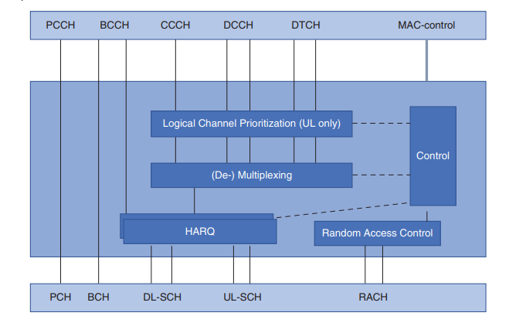
4.2.2 of 3GPP 38.321
Fig 1.1 MAC Layer Architecture

Slide 8
FUNCTIONS AND SERVICES OF MAC LAYER
4.3, 4.4 of 3GPP 38.321
Functions
Mapping between logical channels and transport channels
Multiplexing of MAC SDUs
Demultiplexing of MAC SDUs
Scheduling information reporting
Error correction through HARQ
Logical channel prioritization
Services
Services provided to upper layers
data transfer
radio resource allocation.
Services expected from physical layer
data transfer services
signalling of HARQ feedback
signalling of Scheduling Request
measurements (e.g. Channel Quality Indication (CQI))

Slide 9
Random Access Procedure

Slide 10
Phases of the Random Access Procedure
5.1 of 3GPP 38.321
The procedure typically involves four key steps:
Random Access Preamble Transmission:
The UE selects a preamble, either randomly from a pool (CBRA) or based on network assignment (CFRA), and transmits it on the Physical Random Access Channel (PRACH). The preamble is a short signal that does not carry data but is used to request access.
Random Access Response (RAR):
The network detects the preamble and responds with a Random Access Response message on the Physical Downlink Control Channel (PDCCH). This response includes timing advance information, a temporary identifier (Random Access-Radio Network Temporary Identifier, RA-RNTI), and uplink grant information, allowing the UE to send a message to the network.
Scheduled Transmission:
The UE uses the granted resources to send a message, often referred to as the RRC Connection Request in the context of initial access, or a RRC Re-establishment Request if re-establishing a connection. This message is sent on the Physical Uplink Shared Channel (PUSCH) and includes information that helps the network identify the UE.
Contention Resolution:
For CBRA, if multiple UEs have sent the same preamble, they may both receive the same RAR, leading to a contention scenario. The network sends a contention resolution message, which the UE uses to determine if it has successfully accessed the network. If successful, the UE proceeds with communication; otherwise, it will attempt the Random Access Procedure again.

Slide 11
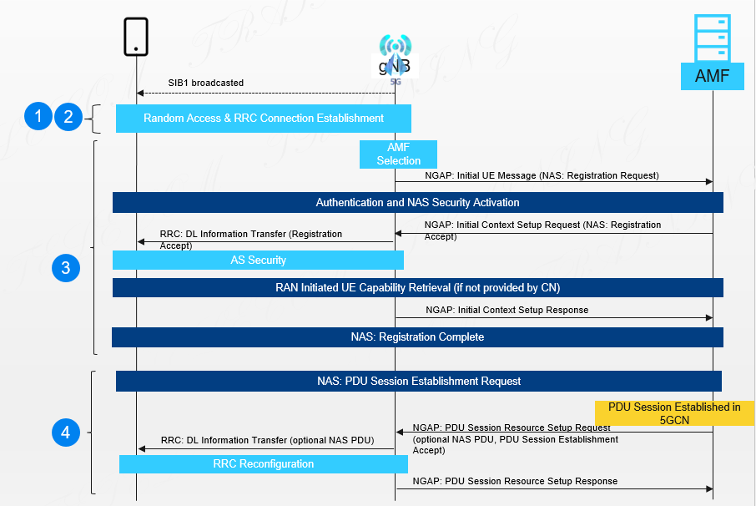
Fig 2.1 Random Access procedure
4.2.2 of 3GPP 38.321
4.5 of 3GPP 38.321

Slide 12
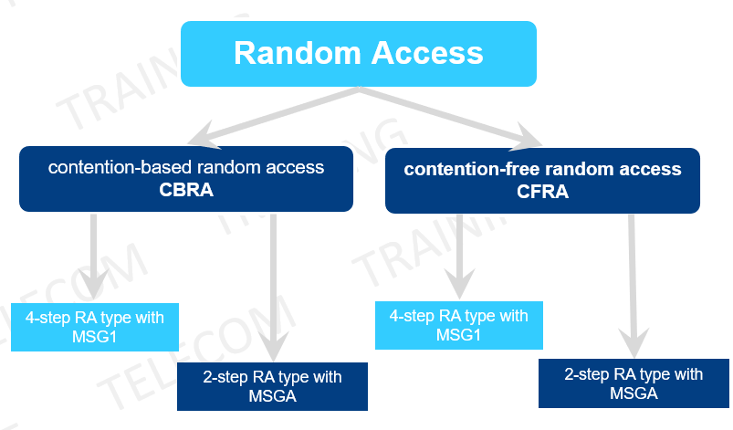
5.1 of 3GPP 38.321
Random Access Procedure
Why and when random access is used?
Initial access from RRC_IDLE
RRC Connection Re-establishment procedure
DL or UL data arrival during RRC_CONNECTED when UL synchronization status is "non-synchronised"
Loss of UL Synchronization
SR failure
Request by RRC upon synchronous reconfiguration
Transition from RRC_INACTIVE
Request for Other SI
Beam failure recovery
Time alignment at scell addition
Fig 2.2Types of Random Access Procedure

Slide 13
C
3GPP 38.221, 38.212, 38.213
3GPP 38.101-1, 2, 38.521-1
Types of Random Access Procedure
There are two types of Random Access Procedures:
Contention-Based Random Access (CBRA):
The UE selects a random access preamble from a shared pool, risking contention with other UEs.
There is a chance that multiple UEs will choose the same preamble, leading to potential contention.
The Random Access Response (MSG2) provides uplink resource allocation for MSG3, and UEs choosing the same preamble will receive identical MSG2 content.
UEs transmitting MSG3 using the same MSG2 will use the same set of resource blocks and symbols.
Contention Resolution is handled differently based on the type of message: For CCCH messages, it uses a MAC Control Element in MSG4. For DCCH or DTCH data, it relies on C-RNTI for addressing and resolution.
The Base Station decodes one MSG3, identifies the successful UE, and informs it through MSG4, while other UEs must retry with a different preamble.
Contention-Free Random Access (CFRA):
The Base Station assigns a dedicated random access preamble to the UE, eliminating the risk of contention.
Since the preamble is uniquely allocated, there is no possibility of contention.
The Random Access Response (MSG2) provides specific uplink resource allocation for MSG3 based on the dedicated preamble.

Slide 14
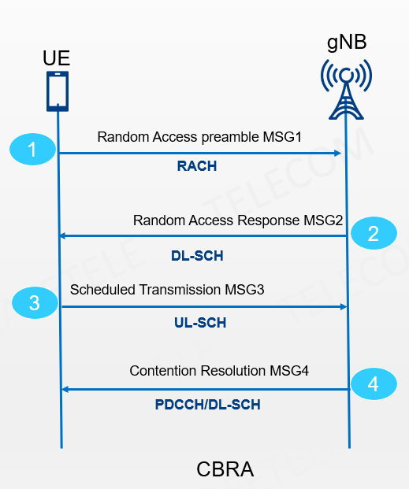
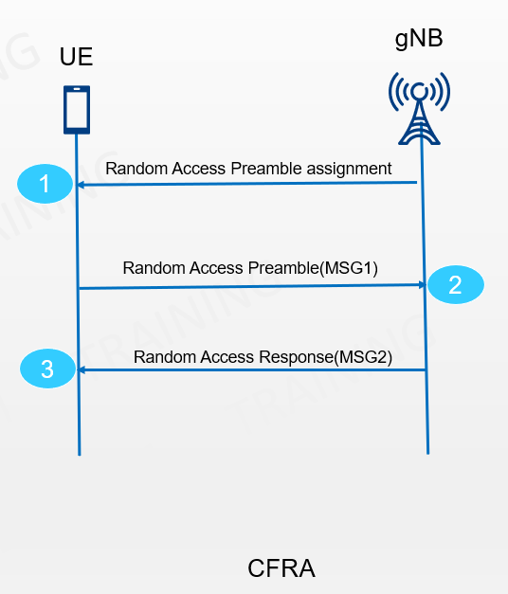
Fig 3.1 CBRA procedure
Fig 3.2 CFRA procedure

Slide 15
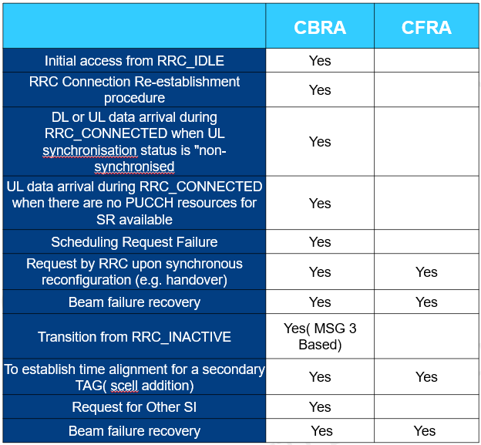
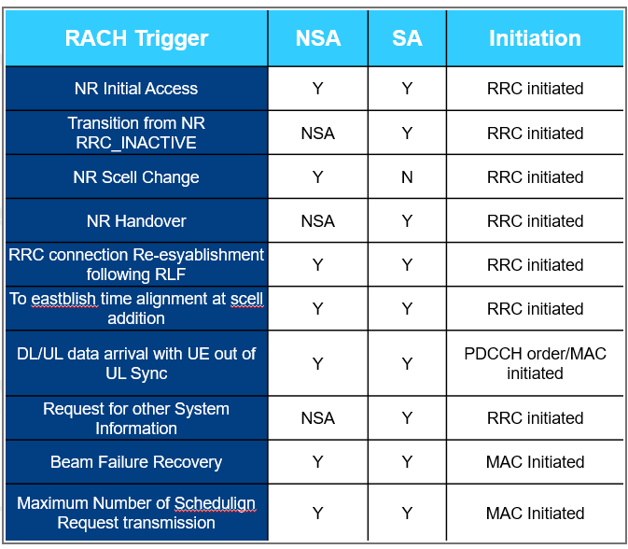
Table 3.1 CBRA vs CFRA comparison
Table 3.2 RACH Trigger Scenarios in NSA vs SA

Slide 16
Code

Slide 18
Code Output

Slide 19
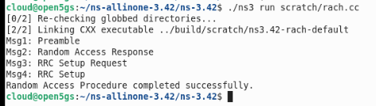
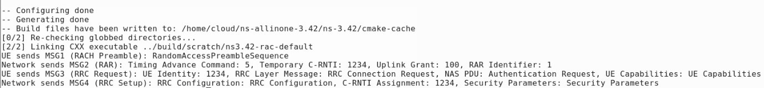

Slide 20
Code Explanation

Slide 21
This code is a simple example of a simulation using the ns-3 network simulator. It demonstrates how to set up a basic LTE network with one user equipment (UE) node and one eNodeB (base station) node, and it simulates the LTE Random Access Procedure. Here's a breakdown of the code:
1. Include Necessary Modules
#include "ns3/core-module.h"
#include "ns3/network-module.h"
#include "ns3/internet-module.h"
#include "ns3/mobility-module.h"
#include "ns3/lte-module.h"
#include "ns3/applications-module.h"
These headers include the various ns-3 modules needed for the simulation. They provide essential classes and functions for core simulation operations, network devices, internet stack, mobility models, LTE networks, and applications.
2. Define the ‘RandomAccessProcedure’ Class
class RandomAccessProcedure : public Application
{
...
};
This class inherits from the ‘Application’ class in ns-3 and simulates the steps of the LTE Random Access Procedure.

Slide 22
Constructor and Destructor
public:
RandomAccessProcedure() {}
virtual ~RandomAccessProcedure() {}
The constructor and destructor are straightforward and don't do anything special.
Start and Stop Application
protected:
virtual void StartApplication()
{
Simulator::Schedule(Seconds(0.0), &RandomAccessProcedure::Msg1Preamble, this);
}
virtual void StopApplication() {}
StartApplication: This method is called when the application starts. It schedules the first message of the Random Access Procedure ‘Msg1Preamble’ to be executed immediately.
StopApplication: This method is called when the application stops. It's empty here but could be used to clean up resources.

Slide 23
private:
void Msg1Preamble()
{
std::cout << "Msg1: Preamble" << std::endl;
Simulator::Schedule(Seconds(1.0), &RandomAccessProcedure::Msg2RandomAccessResponse, this);
}
void Msg2RandomAccessResponse()
{
std::cout << "Msg2: Random Access Response" << std::endl;
Simulator::Schedule(Seconds(1.0), &RandomAccessProcedure::Msg3RrcSetupRequest, this);
}
void Msg3RrcSetupRequest()
{
std::cout << "Msg3: RRC Setup Request" << std::endl;
Simulator::Schedule(Seconds(1.0), &RandomAccessProcedure::Msg4RrcSetup, this);
}
void Msg4RrcSetup()
{
std::cout << "Msg4: RRC Setup" << std::endl;
std::cout << "Random Access Procedure completed successfully." << std::endl;
}
These methods simulate the steps of the LTE Random Access Procedure:
Msg1Preamble: Logs "Msg1: Preamble" and schedules Msg2RandomAccessResponse after 1 second.
Msg2RandomAccessResponse: Logs "Msg2: Random Access Response" and schedules Msg3RrcSetupRequest after 1 second.
Msg3RrcSetupRequest: Logs "Msg3: RRC Setup Request" and schedules Msg4RrcSetup after 1 second.
Msg4RrcSetup: Logs "Msg4: RRC Setup" and indicates the completion of the Random Access Procedure.

Slide 24
3. `main` Function
Simulation Setup
Node Creation: Two nodes are created, one for the UE (`ueNodes`) and one for the eNodeB (`enbNodes`).
Mobility Model: A constant position mobility model is assigned to both nodes, meaning they do not move during the simulation.
Internet Stack: The internet protocol stack is installed on the UE.
LTE Modules: LTE devices are created for the eNodeB and UE, and the UE is assigned an IP address.
Attach UE to eNodeB: The UE is attached to the eNodeB, establishing a connection.
Custom Application Setup
A `RandomAccessProcedure` application is created and added to the UE node. It is scheduled to start after 1 second.
Simulation Execution
The simulation is run for 5 seconds (`Simulator::Stop(Seconds(5.0))`), during which the Random Access Procedure is executed.
This code essentially simulates the Random Access Procedure of LTE, which is a key part of how a UE connects to an LTE network.

Slide 25
Thank You!
From Team 4:
Rajeshwari
Swetav
Sujata
Pavan
Prasad
Shashwat
Bhuvaneshwari

